Slide 1
WORK UPDATES PRESENTATION
FROM
Rishabh Kumar Srivastva
SAP ID- 52108159

Slide 2
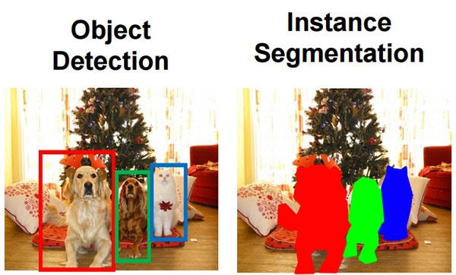
Segmentation
What is Image Segmentation
By using image segmentation techniques, you can divide and group-specific pixels from an image, assign them labels and classify further pixels according to these labels. You can draw lines, specify borders, and separate particular objects (important components) in an image from the rest of the objects (unimportant components).
Object Detection v/s Image Segmentation
Object detection builds a bounding box corresponding to each class in the image. But it tells us nothing about the shape of the object. We only get the set of bounding box coordinates. We want to get more information – this is too vague for our purposes.
Image segmentation creates a pixel-wise mask for each object in the image. This technique gives us a far more granular understanding of the object(s) in the image.

Slide 3
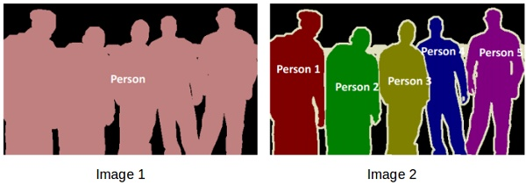
2 Types of Segmentation Problems
In image 1, every pixel belongs to a particular class (either background or person). Also, all the pixels belonging to a particular class are represented by the same color (background as black and person as pink). This is an example of Semantic segmentation
Image 2 has also assigned a particular class to each pixel of the image. However, different objects of the same class have different colors (Person 1 as red, Person 2 as green, background as black, etc.). This is an example of Instance segmentation
In above figure, If there are 5 people in an image, semantic segmentation will focus on classifying all the people as a single instance. Instance segmentation, on the other hand will identify each of these people individually.

Slide 4
SEAFORMER: SQUEEZE-ENHANCED AXIAL TRANSFORMER
The landscape of many computer vision tasks (e.g., semantic segmentation), which has been overwhelmingly dominated by CNNs, recently has significantly revolutionized. However, the computational cost and memory requirement render these methods unsuitable on the mobile device, especially for the high-resolution per-pixel semantic segmentation task. To, solve these issues we have SeaFormer.
SeaFormer (squeeze-enhanced Axial Transformer) is a mobile-friendly image segmentation model that is built using transformers. It reduces the computational complexity of axial attention to achieve superior efficiency on mobile devices.

Slide 5
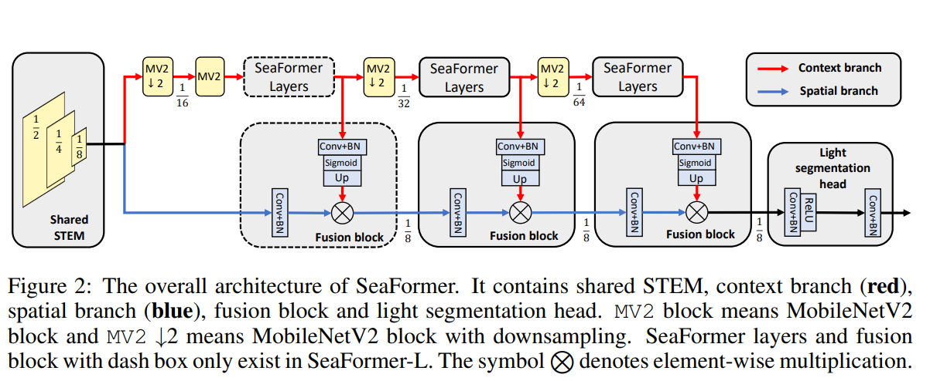
STEM branch: . It consists of one regular convolution with stride of 2 followed by four MobileNet blocks where stride of the first and third block is 2

Slide 6
MobileNetV2 : Mobilenet as a backbone can achieve fast object detection optimized for mobile devices. This class of models is based on a simplified architecture that uses depth-separable convolutions to build lightweight deep neural networks. It decomposes standard convolution into depth convolution and a 1×1 convolution known as point convolution. A standard convolution has one step for both filtering and combining the inputs into a new set of outputs. But the depth-separable convolution splits it into two layers, a separate layer for filtering and a separate layer for combining. This factorization drastically reduces the computation and model size.
Seaformer Layers: The core building block is what they call squeeze-enhanced axial (SEA) attention. This block acts like a data compressor to reduce the input size. It seeks to squeeze (pool) the input feature maps along both the horizontal/vertical axis into a compact column/row and then computes self-attention. Here, they have first implemented horizontal squeeze by taking average of query feature map on the horizontal direction. In the same way, the vertical squeeze on the vertical direction is also done.
Contextual Branch: Context can be formulated in terms of semantic compatibility relations between one object and its neighboring objects or image patches (stuff), in which a compatibility relation is an indication of the co-occurrence of visual patterns. For example, a car is likely to appear over a road, and a glass is likely to appear over a table. Context can also encode incompatibility relations. For example, a boat is unlikely to appear on a road.
Spatial Branch: Space represents the 2D plane(x, y) in images. Thus, Spatial information in CNN for example in the first convolutional layer, extracts low-level features like edges, corners, etc. and in the later Convolutional layer it extracts spatial information like eyes, nose, etc. This is spatial information in images. CNN's don't maintain the spatial relationships among features.

Slide 7
Fusion block to fuse the features in the context branch into the spatial branch, bringing high-level semantic information into the low-level spatial information. Then, the semantics weights from context branch are element-wisely multiplied to the high-resolution feature from spatial branch
DataSet: ADE20K Zhou et al. (2017), CityScapes Cordts et al.(2016). ADE20K dataset covers 150 categories, containing 25K images that are split into 20K/2K/3K for Train, val and test. CityScapes is a driving dataset for semantic segmentation. It consists of 5000 fine annotated high-resolution images with 19 categories.

Slide 8
SEAFORMER Implementation
Libraries Installed and configured
Install PyTorch
!pip install -U torch==1.12.0+cu116 torchvision==0.13.0+cu11.6 –f https://download.pytorch.org/whl/torch_stable.html
Install dependencies required to create the environment: Dependencies between Pytorch and mmcv were successfully resolved.
!pip install mmcv-full==1.6.0 -f https://download.openmmlab.com/mmcv/dist/cu116/torch1.12/index.html
pip install timm==0.3.2
pip install mmsegmentation
Install MMDetection from the source repository : MMDetection is a toolbox containing many pre-built models and each model has its own architecture, this toolbox defines a general architecture that can adapt to any model.
Adding light_head.py(decoder file) and seaformer.py(encoder/feature extraction file) to mmseg repo.

Slide 9
Future Scope of Work
To be discussed

Slide 10
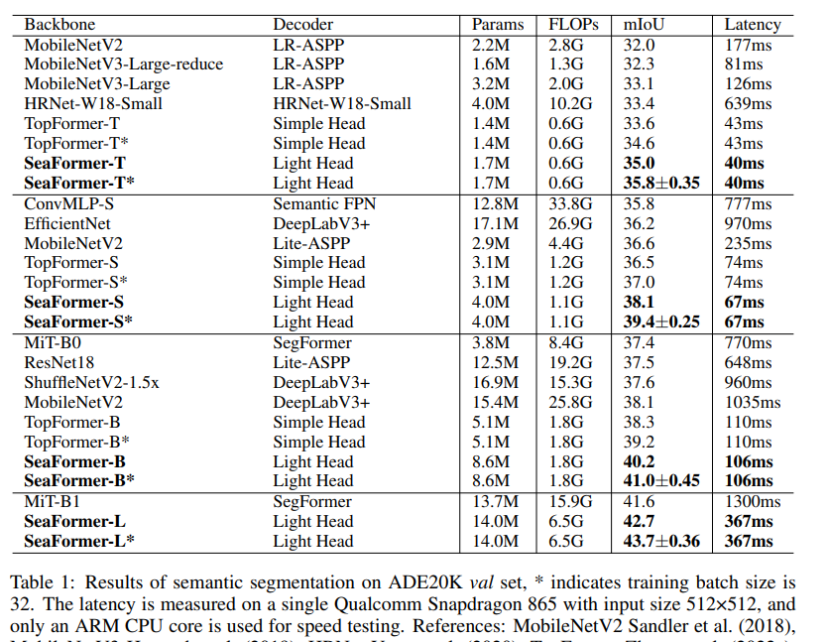

Slide 11
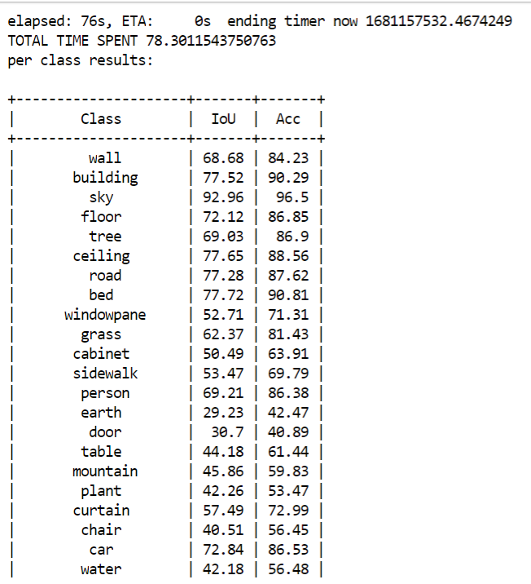
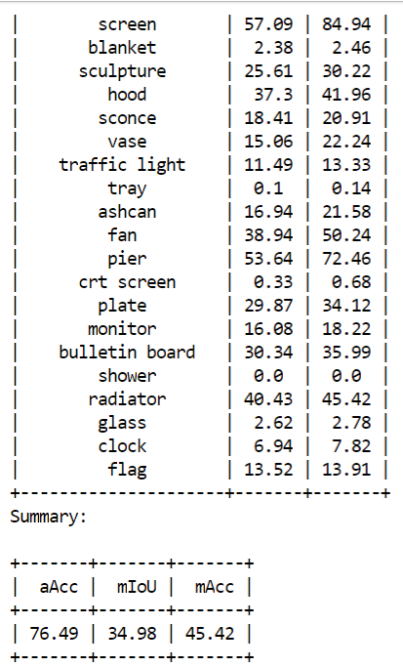
Seaformer-Tiny

Slide 12
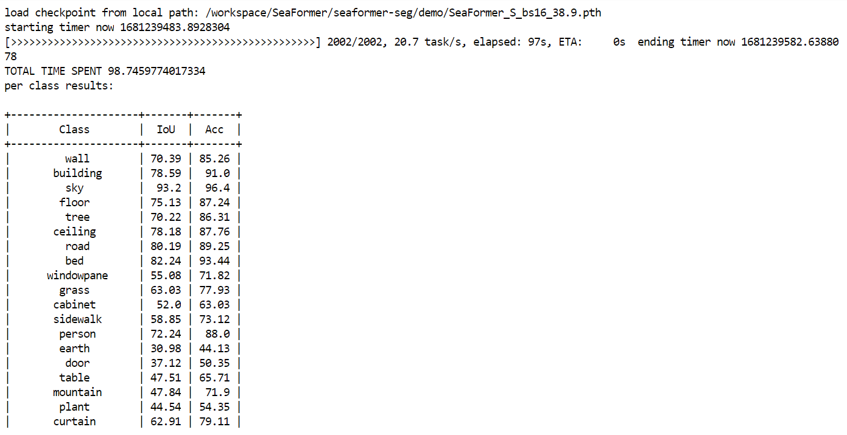
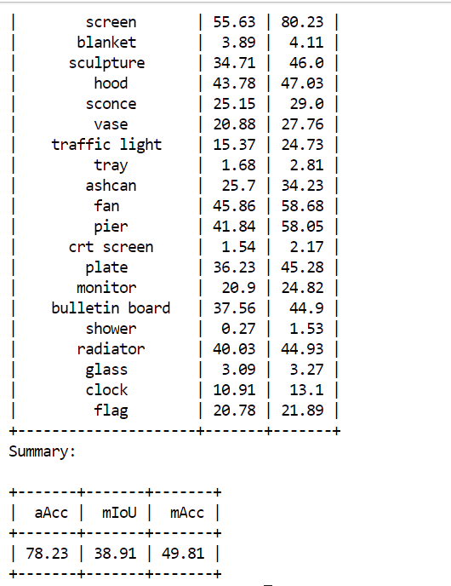
Seaformer-Small

Slide 13
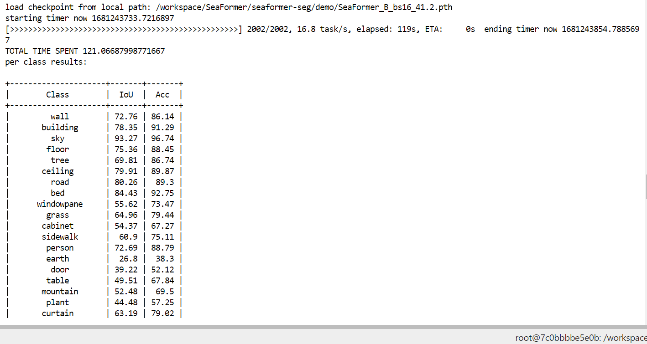
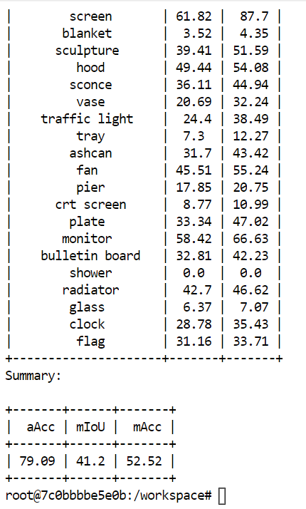
Seaformer-Base

Slide 14
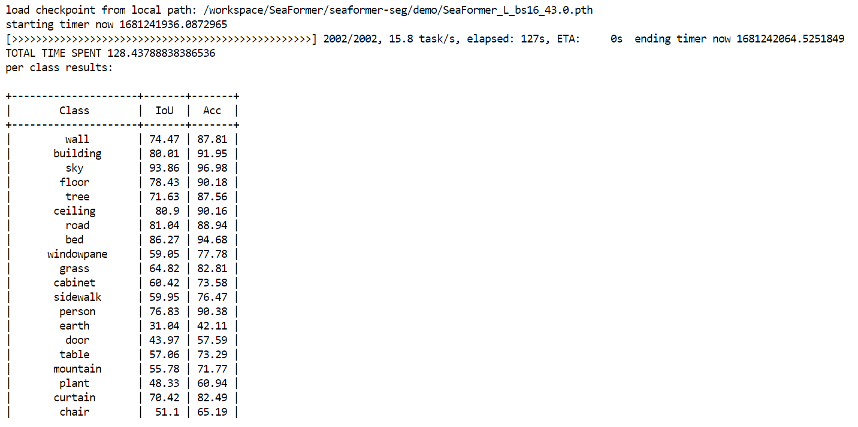
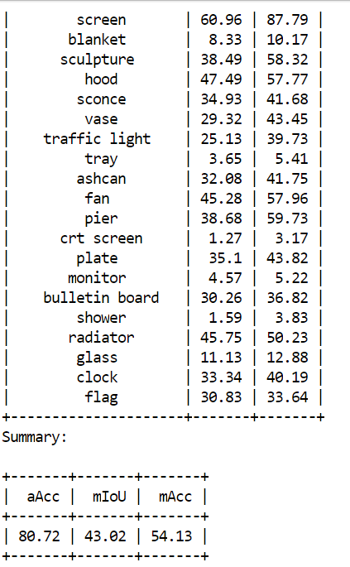
Seaformer-Large

